Slide 1
How to estimate the Bill of Material Ratios using U.S. Economic Census
Identify the Industry Code based on the Supplier’s Business and Product
Step 2
Record the types and cost of materials consumed by the industry
Step 4
Calculate the Bill of Material ratios for the industry
Step 1
Obtain the latest available Economic Census data from the US Bureau of Census for the industry of interest
Step 3

Slide 2
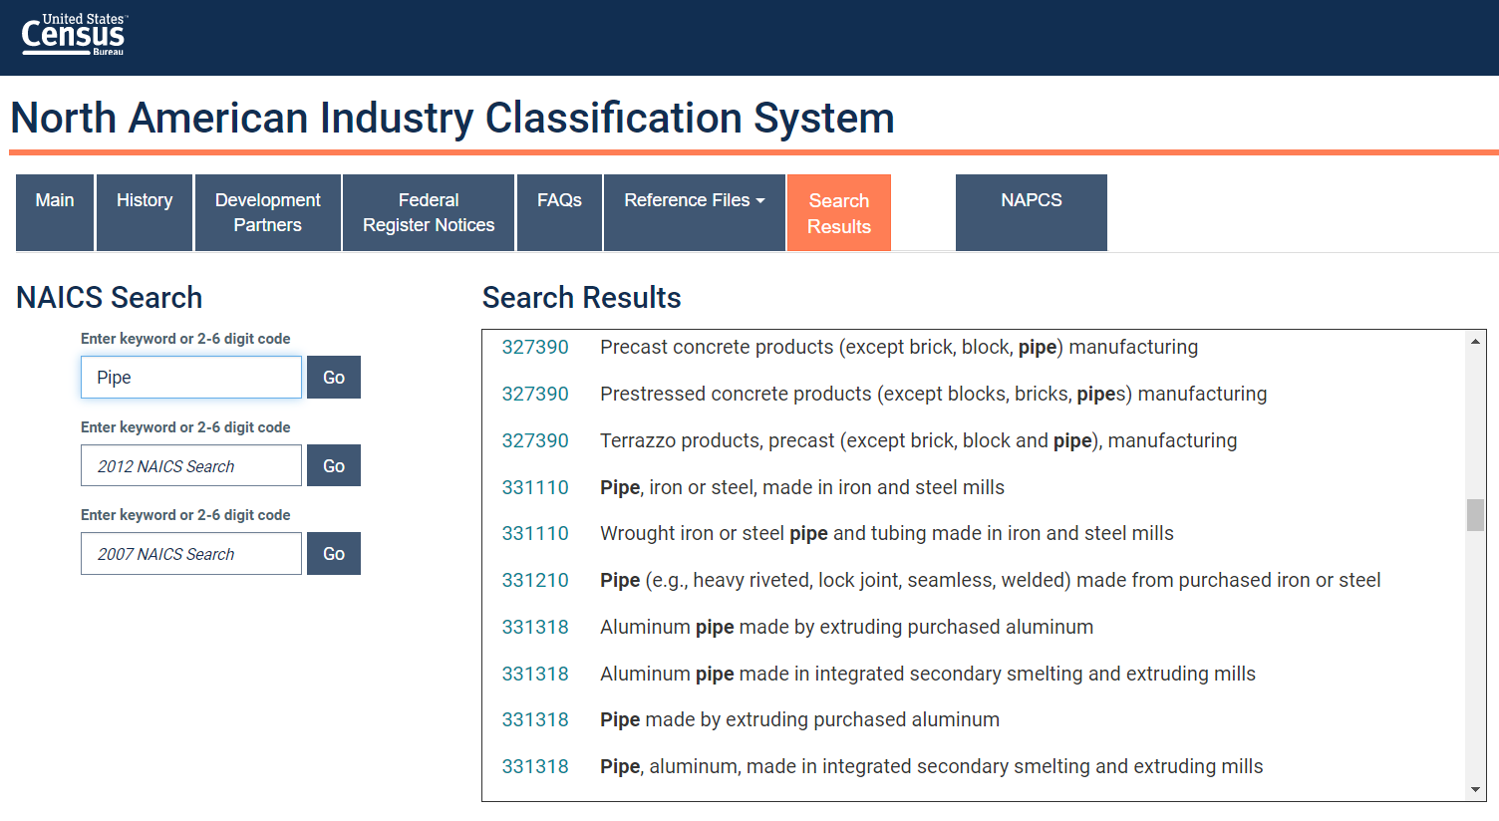
Select the Industry Code Based on the Supplier’s Business and Product
Step 1
Go to:
Conduct a word search to find possible NAICS codes for the product
Select the NAICS code with the best match and record for later use
https://www.census.gov/naics/
Tip: click on the code to view its full definition

Slide 3
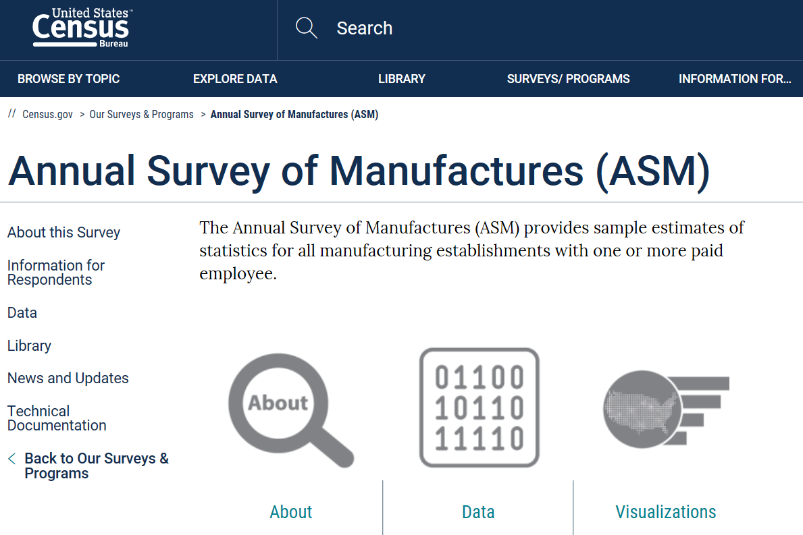
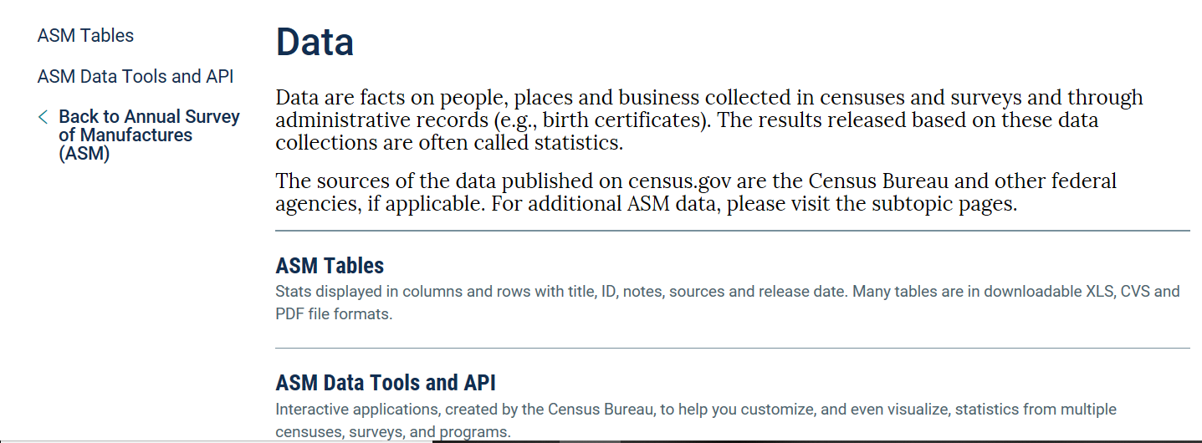
Obtain the latest available Economic Census data from the US Bureau of Census for the industry of interest
Step 2
Go to:
Select Surveys and click Annual Survey of Manufacturers
Select Data. Click ASM Data Tools and API.
Click on Explore Census Data
www.census.gov

Slide 4
Obtain the latest available Economic Census data from the US Bureau of Census for the industry of interest
Step 2
In the search box, type Materials Consumed
In the results, select table id EC1731MATFUEL: Manufacturing: Materials Consumed by Kind of Industry

Slide 5
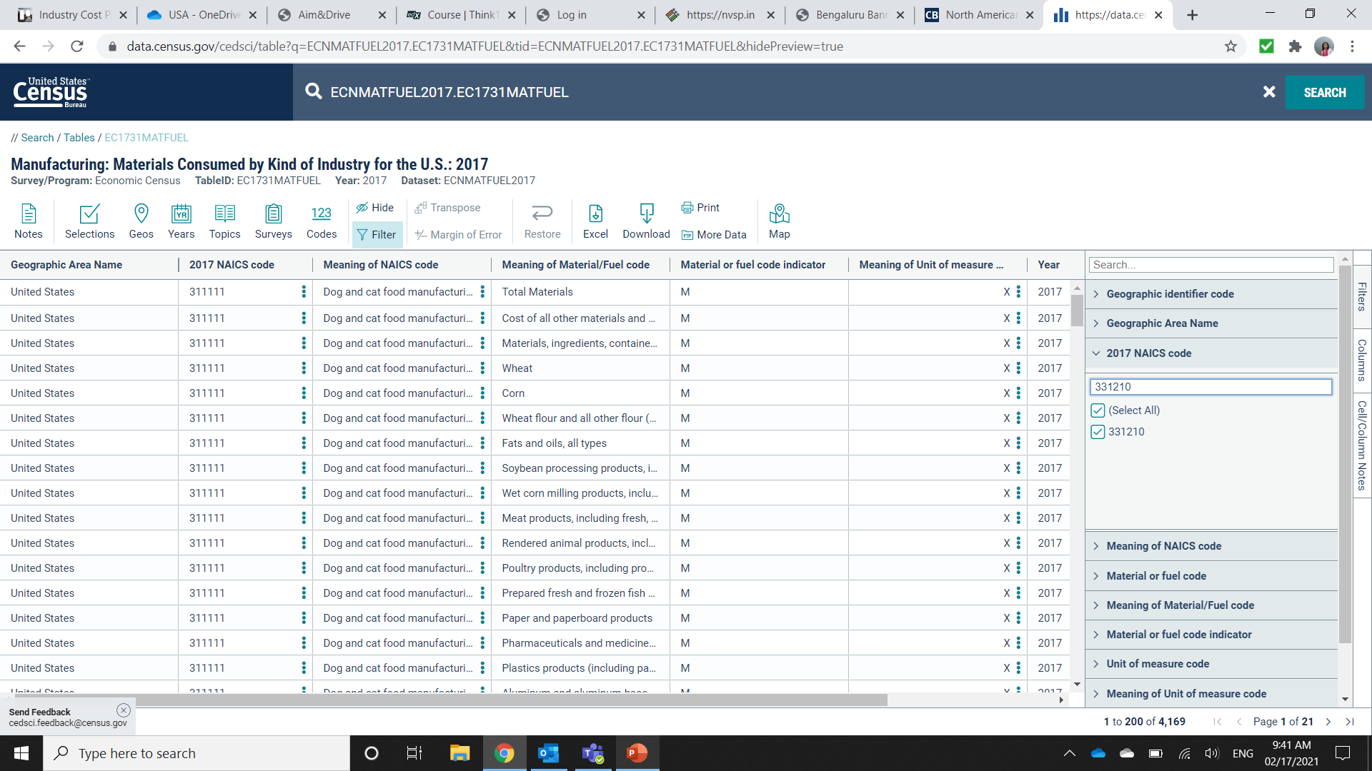
Obtain the latest available Economic Census data from the US Bureau of Census for the industry of interest
Step 2
Click on Filter
In the dropdown on the right side, select 2017 NAICS Code
In the search bar, type your industry of choice, in this case 331210 and press Enter

Slide 6
Record the types and cost of materials consumed by the industry
Step 3
The table can be downloaded or copied and pasted into Excel
The table lists the types and cost of materials consumed by the industry

Slide 7
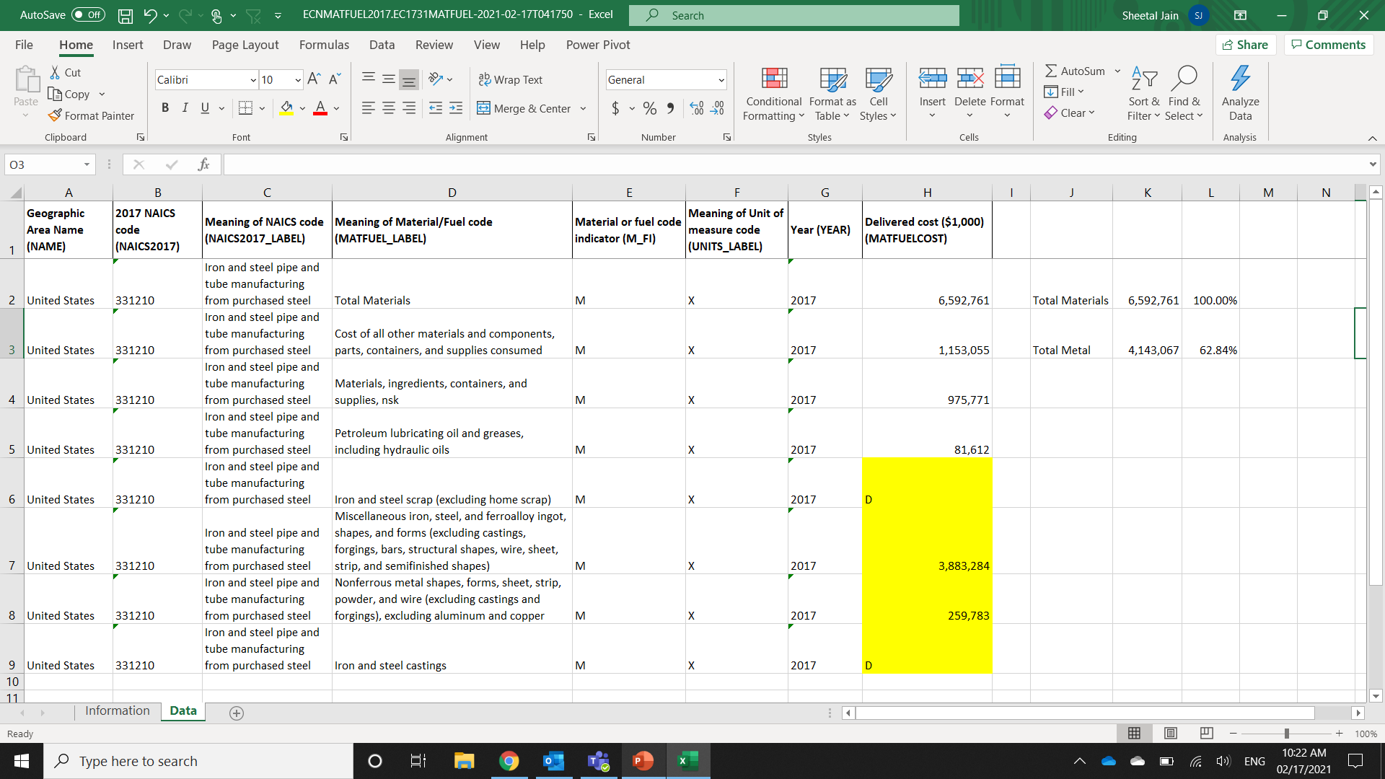
Calculate the Bill of Material ratios for the industry
Step 4
In Excel, calculate the Material cost proportions and use as proxy for Bill of Material ratios.
In this example, we isolate metal from non-metal materials. This will give us the ratio of metal materials to total direct materials

Slide 8
Tip
Use the U.S. Bill of Material ratios as a proxy ratio when building an Industry Cost Profile for another country.

